Slide 1
DAY2-TABLEAU
SALES ANALYSIS
-Mamatha Ramanujam

Slide 2
Scenarios
1. Find the sales for every year and find the highest sales and show the view in bar graph.
2. Find the category wise sales for every year.
3. Display subcategory and find some insights from the view about max and min sales under every category.
4. In your bar graph present subcategory under each bar of category using colour card.
Note : - Use Superstore data

Slide 3
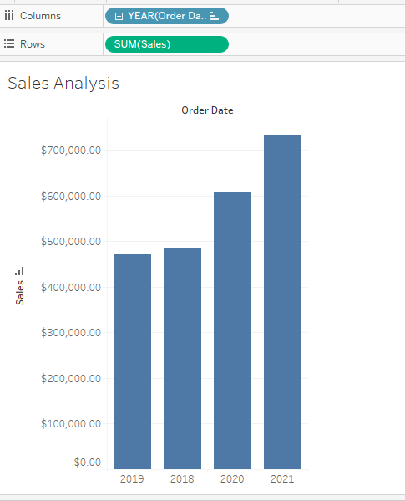
1. Find the sales for every year and find the highest sales and show the view in bar graph.
Step1 : Drag and drop Order date category to columns and Sales unit in Rows
Visualization represents the bar graph which shows the highest sale is in the year 2021

Slide 4
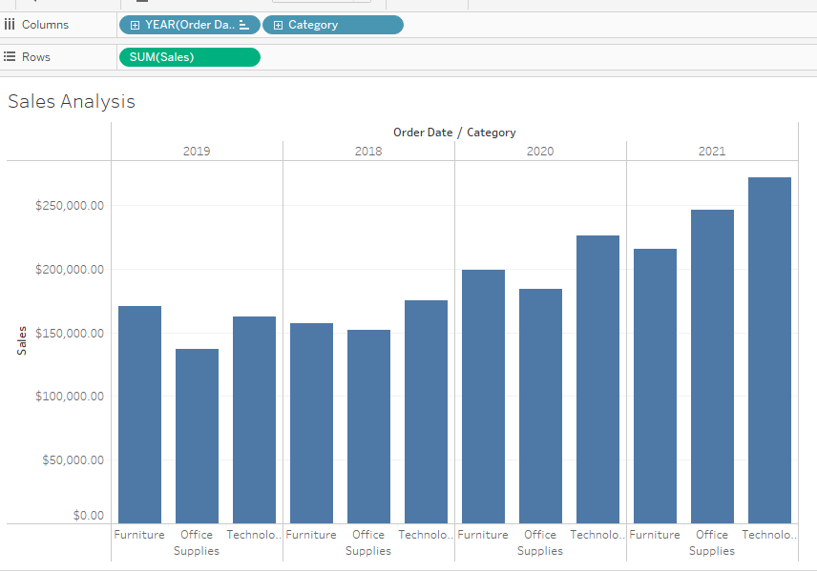
2. Find the category wise sales for every year.
Step2: Add the category unit to columns which provides category wise sale every year

Slide 5
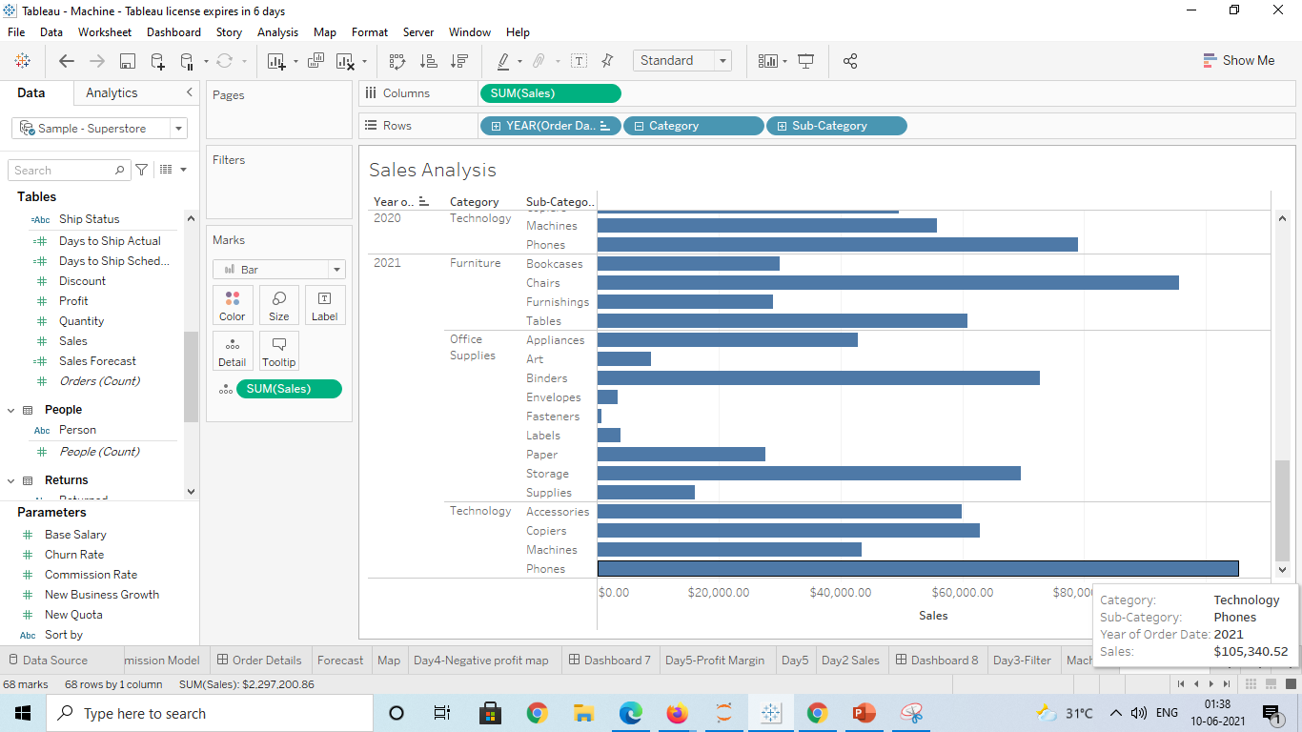
3. Display subcategory and find some insights from the view about max and min sales under every category.
Step3: Add the sub category to shelf and depicts that
In Maximum Sales :
Category: Technology
Sub Category: Phones
Sale:$105,340
Year:2021
Minimum Sales:
Category: Office Supplies
Sub Category: Fasteners
Sale:$545
Year:2019

Slide 6
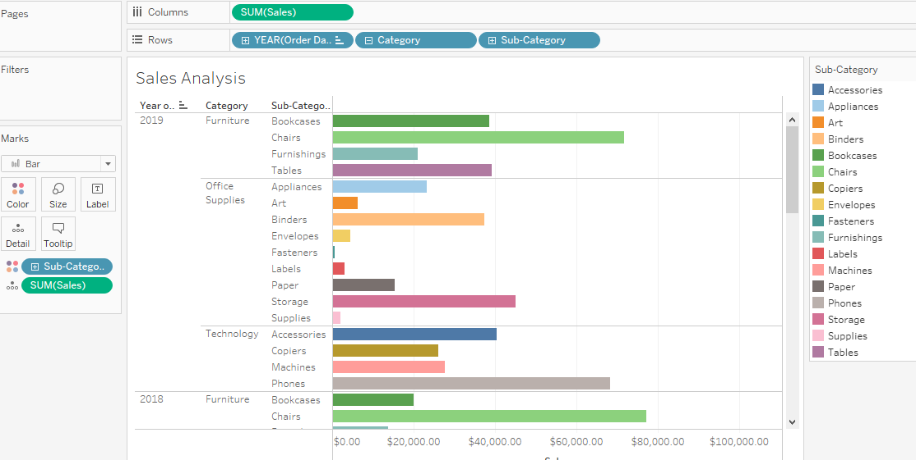
4. In your bar graph present subcategory under each bar of category using color card.
Step4: Drag and drop the sub category into color under Marks

